Slide 1
Automation on amazon using selenium and jenkins
PRESENTED BY : VENNELA PALLERLA
EMP ID : 201347

Slide 2

contents
Introduction
Spring Boot
Selenium
TestNg
Jenkins

Slide 3
introduction
This presentation is about the automating the website using selenium tool.
This project shows that how we can automate the process by different functions and we can load the website and perform various functionalities using selenium.

Slide 4
Spring Boot
Spring framework is an open source java framework
It provides an easier and faster way to set up, configure, and run both simple and web-based applications.
It is light weight framework.

Slide 5
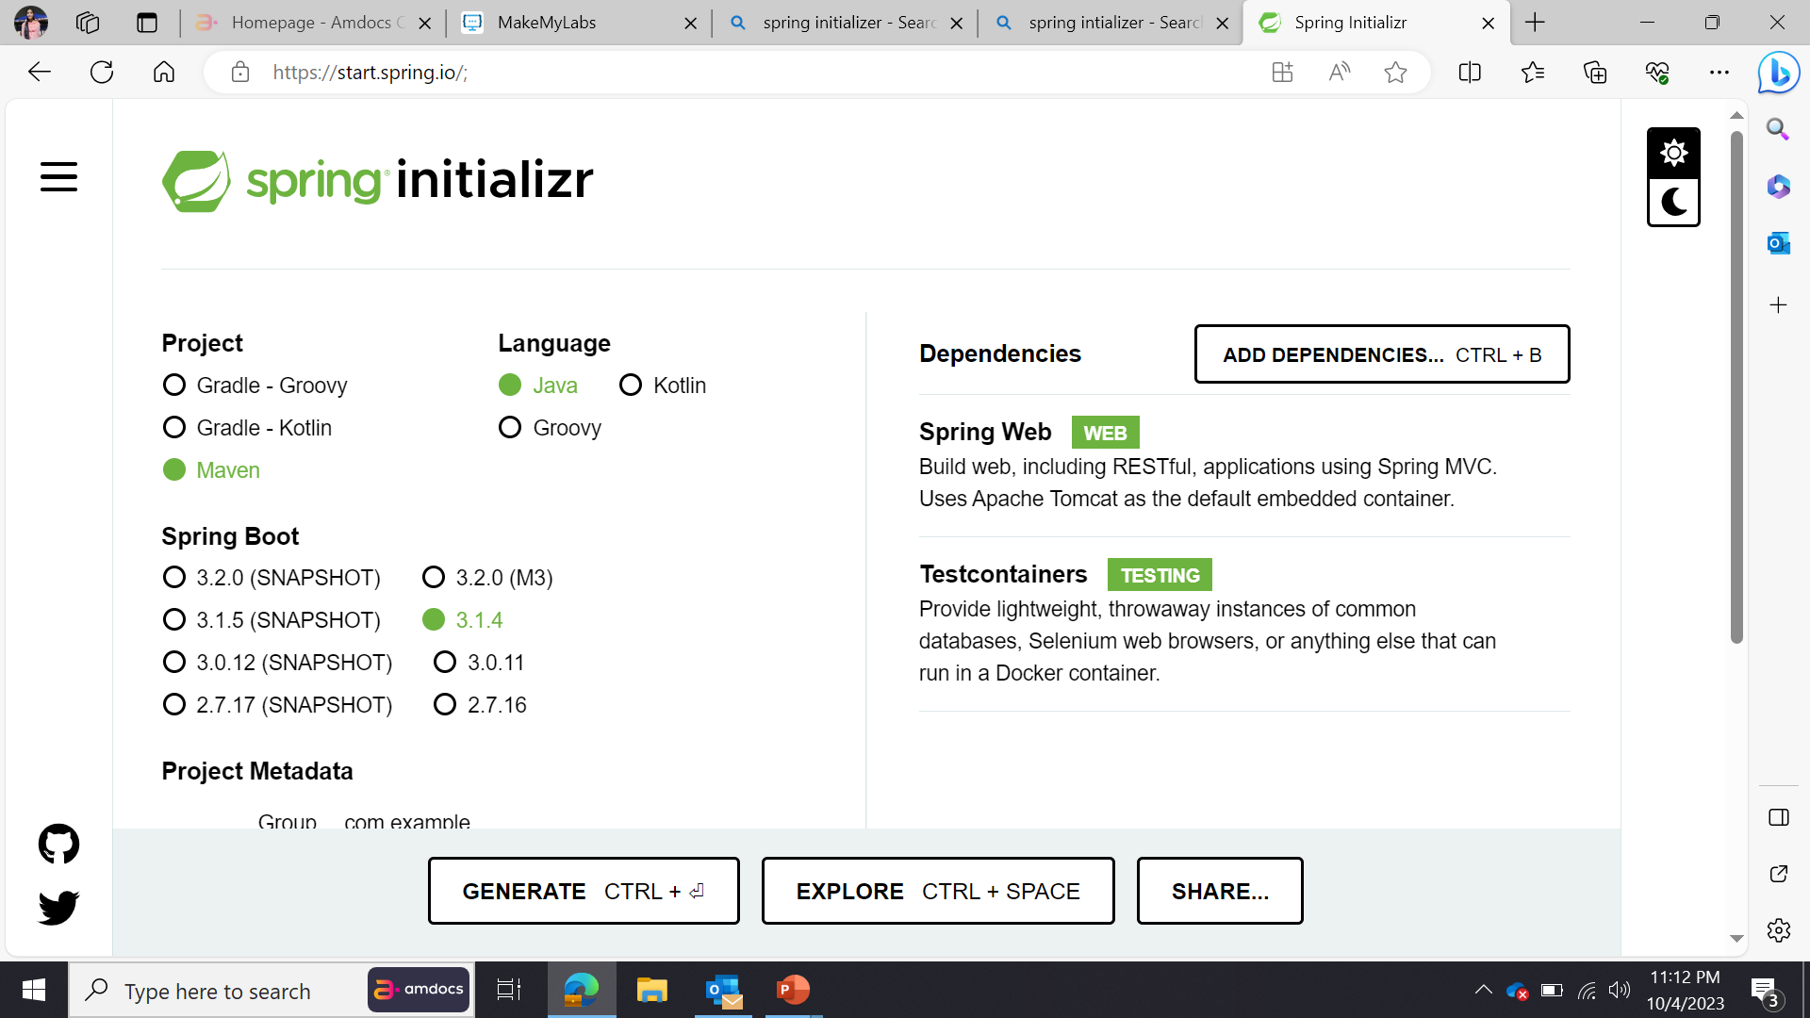
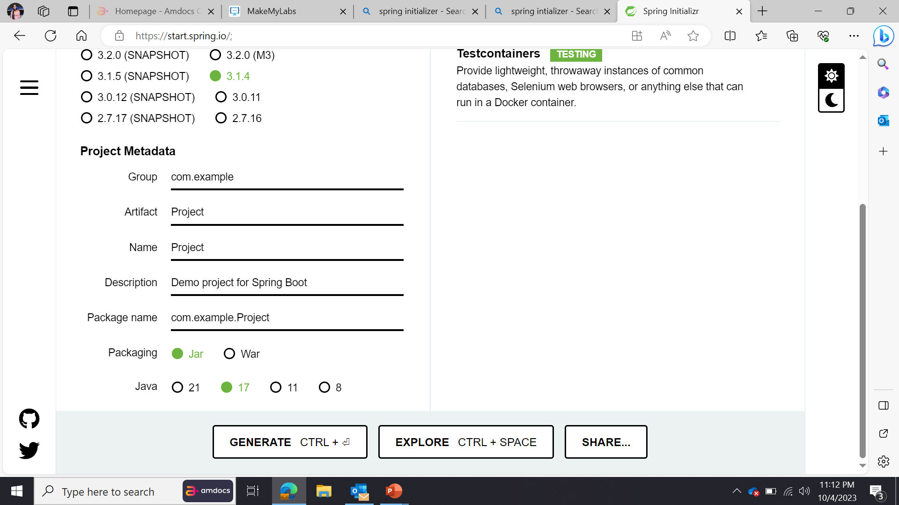
Spring boot initializr

Slide 6
selenium
Selenium was introduced by Jason Huggins in 2004.
Selenium is a open-source framework used for automating web browsers.
Selenium supports multiple web browser like chrome,firefox,edge.
It supports multiple programming languages like java,python,c#.

Slide 7
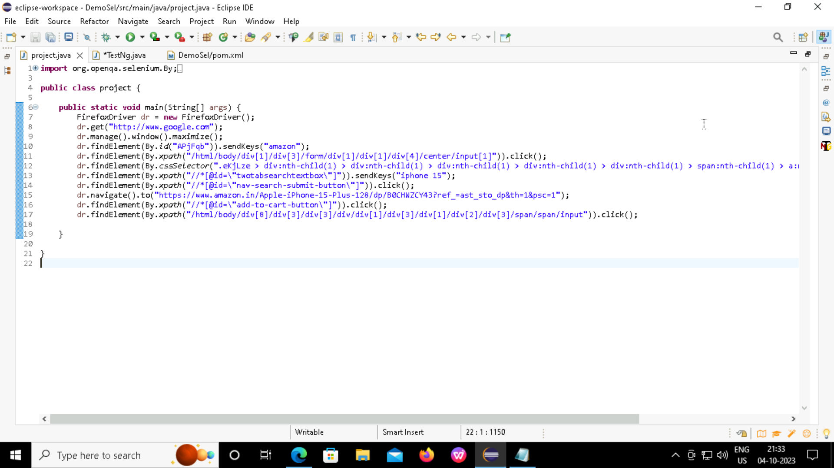
Source code

Slide 8
testng
It is an open source automated TestNG framework. In TestNG, NG stands for "Next Generation".
TestNG framework came after Junit, and TestNG framework adds more powerful functionality and easier to use.
TestNG enables you to group the test cases easily which is not possible in JUnit.
TestNG framework came after Junit, and TestNG framework adds more powerful functionality and easier to us

Slide 9
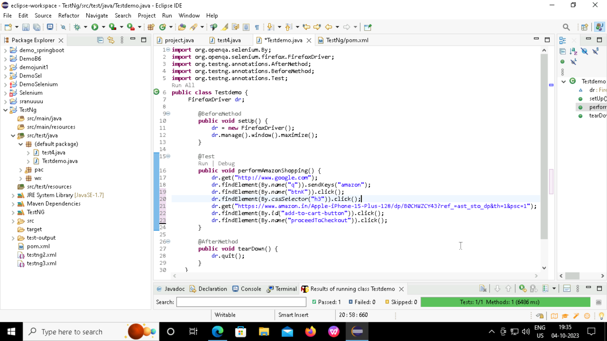
TESTNG source code

Slide 10
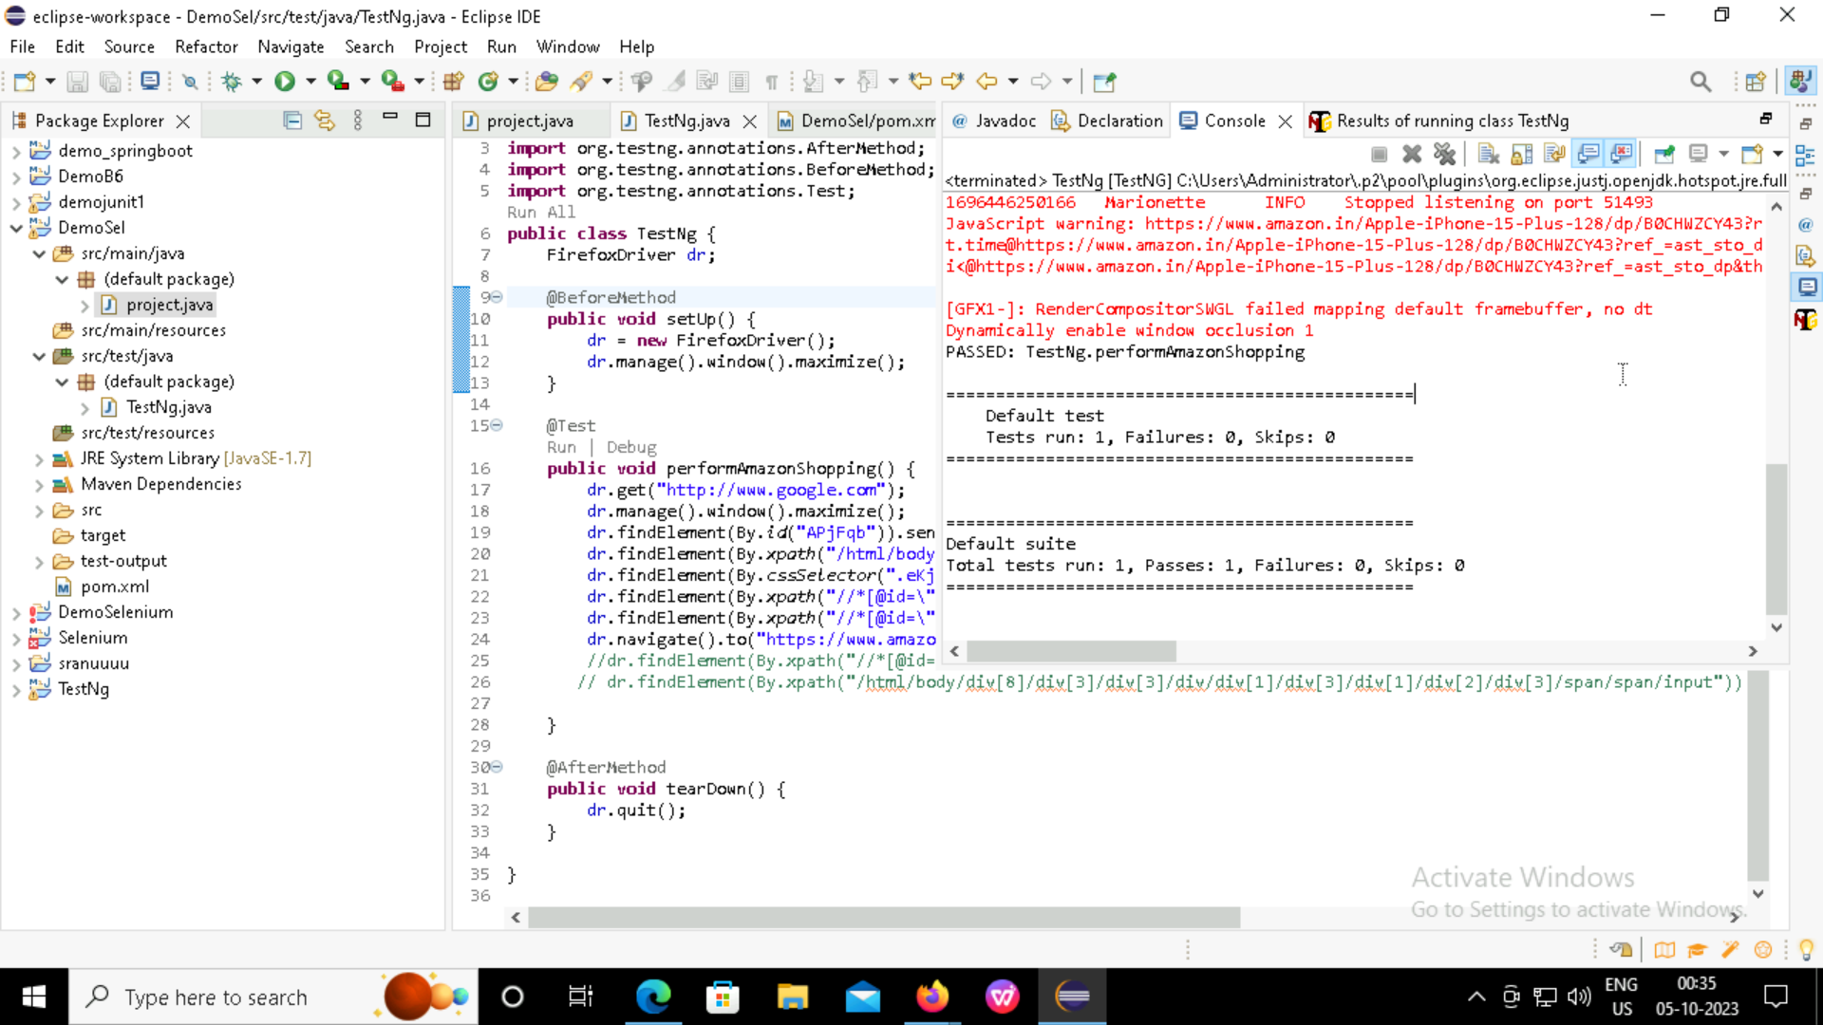
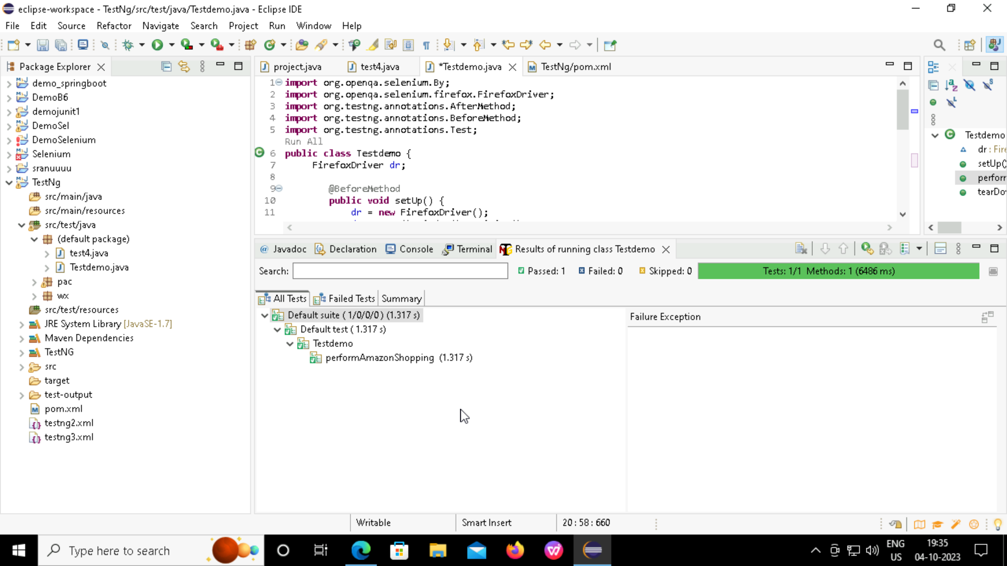
testcase

Slide 11
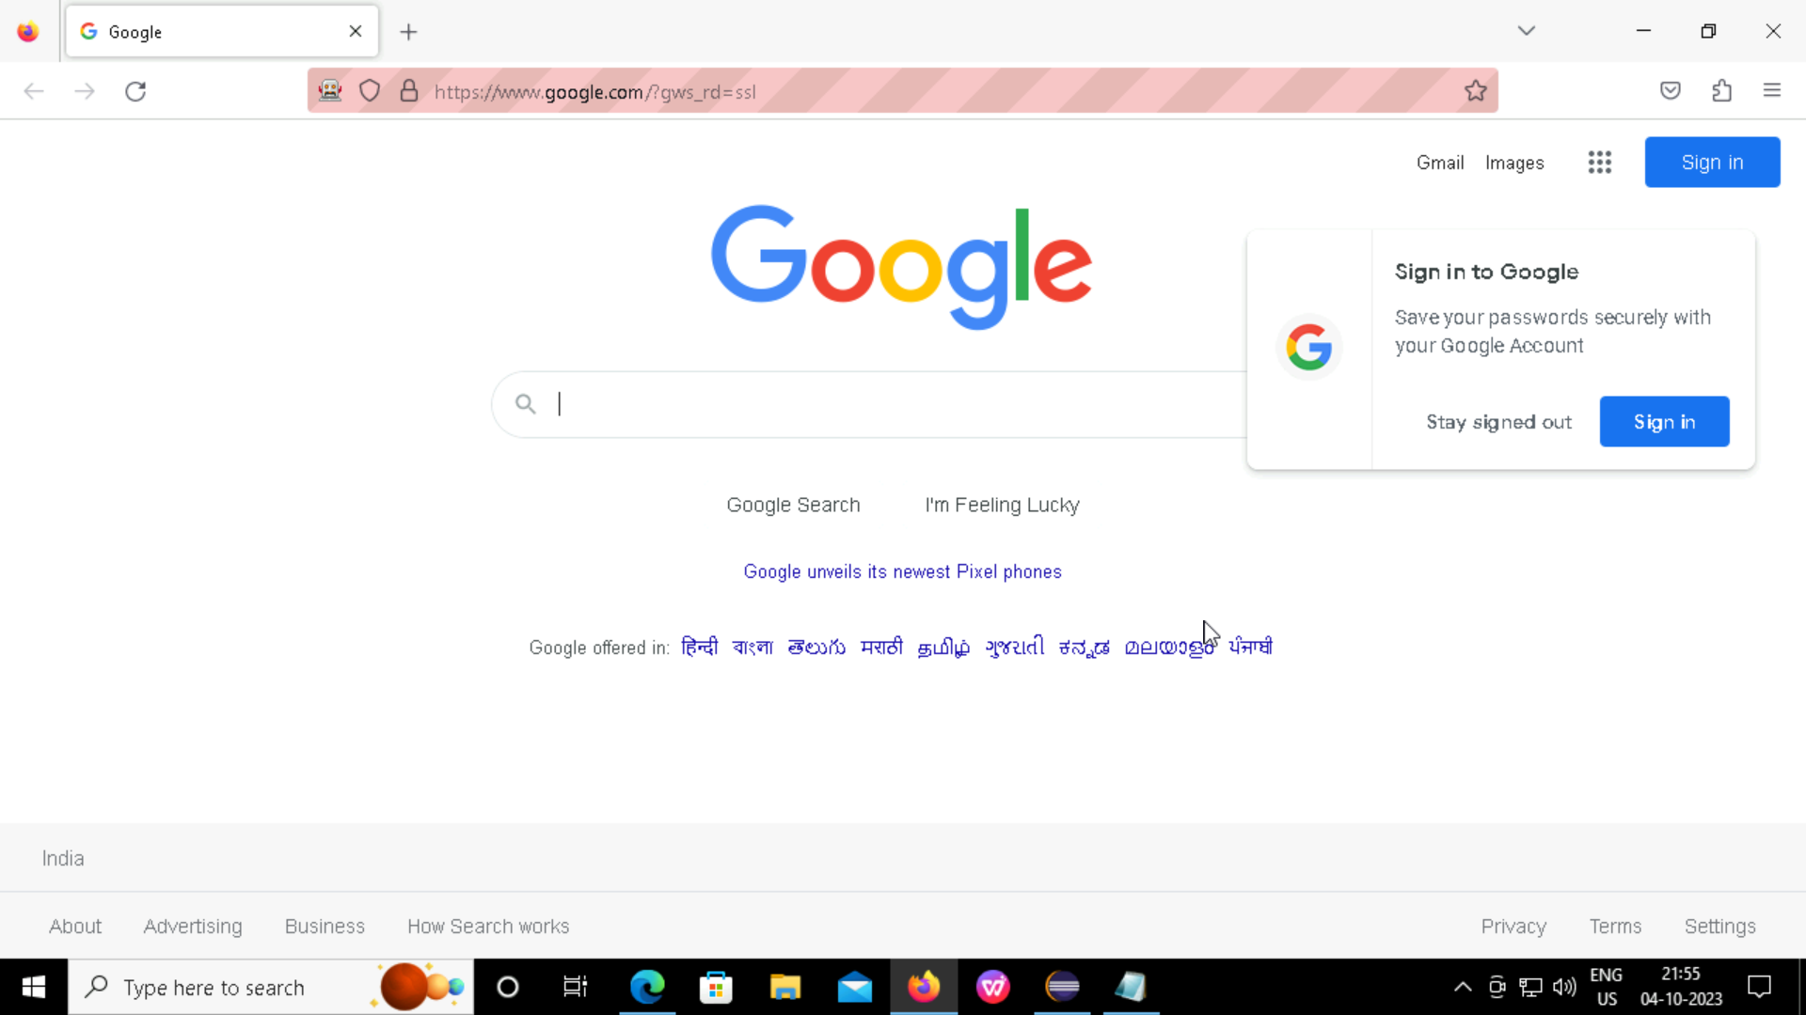
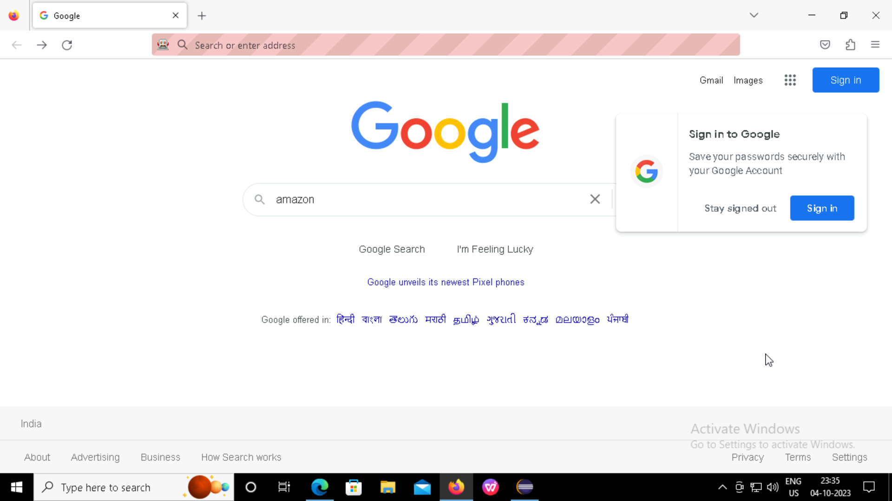
Output

Slide 12
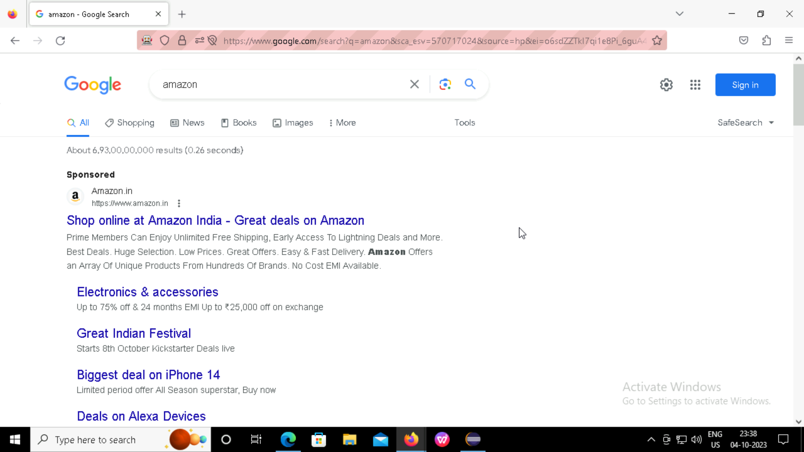
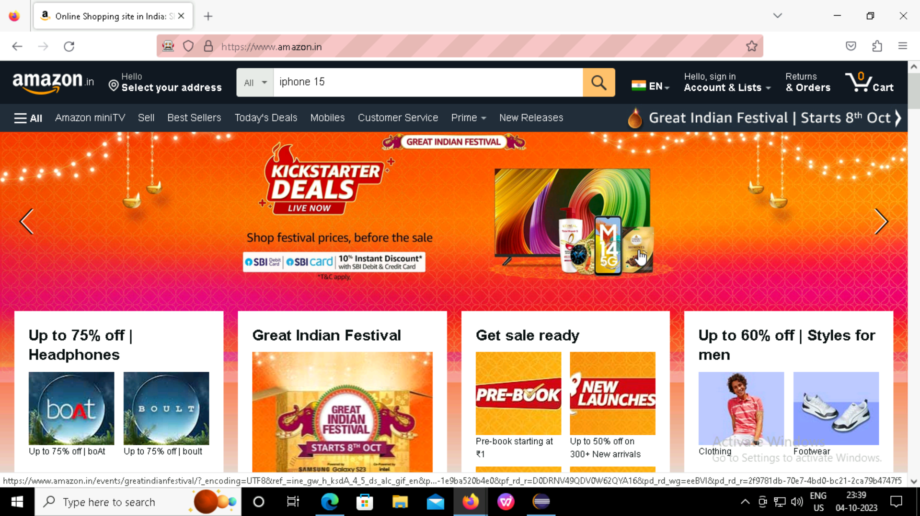

Slide 13
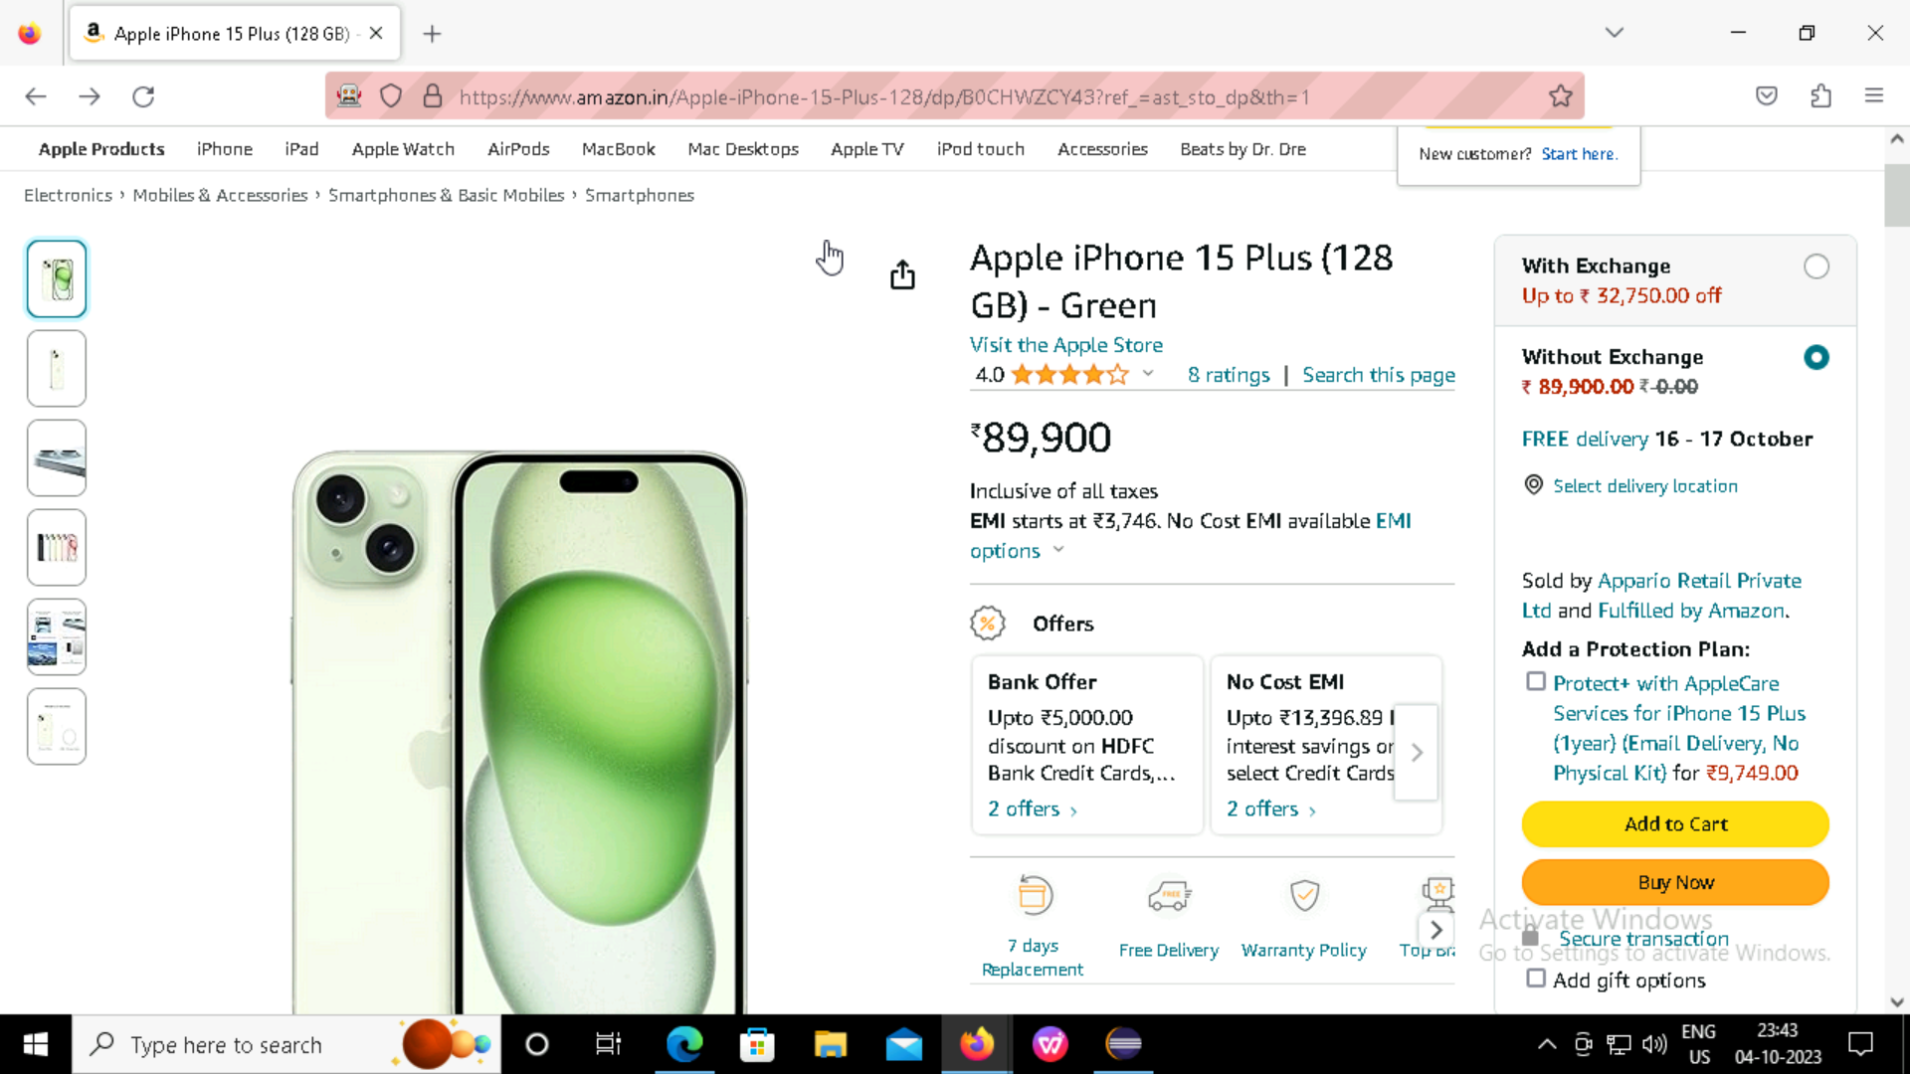
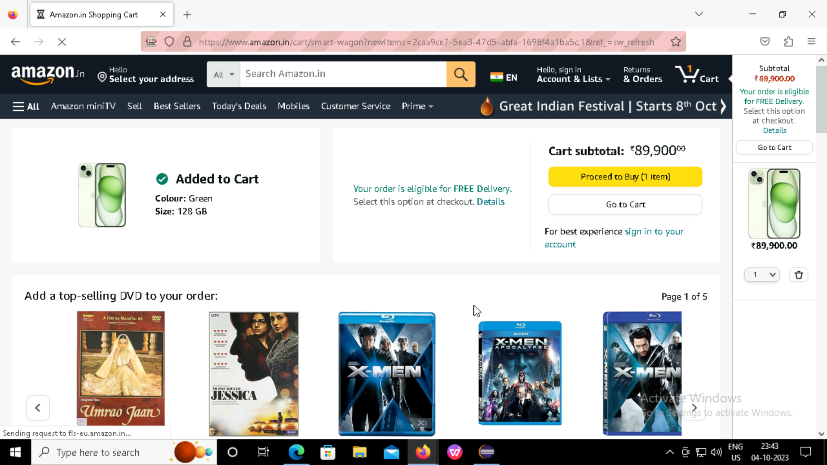

Slide 14
jenkins
Jenkin is an open source automation tool written in java programming language that allows continuous integration.
continuous integration and continuous delivery enables the integration of code changes are tested and deployed efficiently.

Slide 15
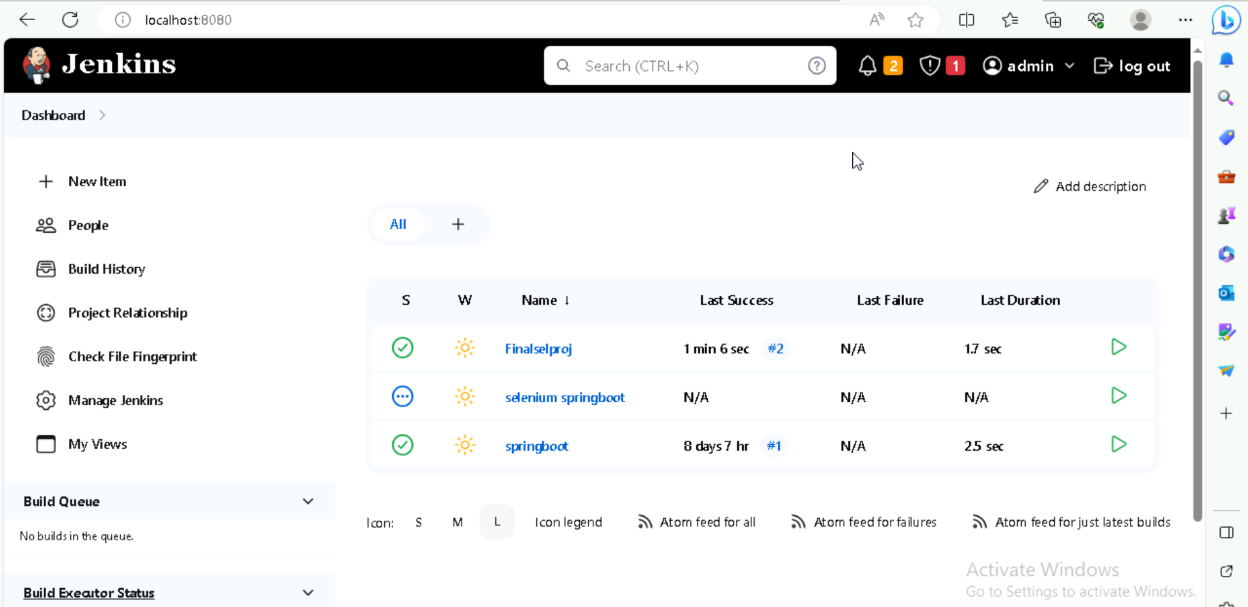
Jenkins Build Ui

Slide 16
Thank you

